Slide 1
Data Analysis of Real Estate Prices and Venues in Bangalore

Slide 2
Introduction
Business Problem:- Bangalore is the capital of the Indian state of Karnataka. Real estate requires large sums of capital and is not as liquid as other investment avenues like mutual funds, stocks and bonds. Real estate investment in Bangalore is very tricky, not all investments are in profit. Locality is the most important factor for profitability in real estate investment. Proximity to amenities, peaceful conforming areas, neighborhood status, scenic views, etc. are major factors for residential property valuations. While proximity to markets, warehouses, transport hubs, freeways, tax-exempt areas, etc. play an important role for commercial property valuations.
Real estate investor should invest only if he/she is very sure about the commercial developments in that location and proximity to all amenities as its the backbone for one’s rentals and sales. At the same time, the investment should be affordable.
Its very challenge to a new real estate investor to find such lucrative area in such a big city. By looking at the above pros and cons of real estate investment, as a data scientist, provide a solution which should help to the investor to find the desirable place.
Target Audience:- Individual or corporate real estate investors who are interested in growing Bangalore’s real estate and explore its neighborhoods & common venues around each neighborhood.

Slide 3
Data Acquisition and Cleaning
Data Acquisition:- Obtained the following data along with Foursquare location data to solve the problem.
Latest Bangalore’s real estate prices data from Makaan.com which is an online real estate portal in India.
Most common venues data of a given locality of Bangalore via Foursquare API
Data Cleaning:- The following activities done to get desirable clean data set.
Extracted the data from makaan.com using web scrape technique.
Took only required columns such as Locality and Avg_price_per_sqft. Removed all the localities for which the Avg price is not available. Converted the price data type to integer.
Obtain coordinates of the localities in Bangalore using geopy.
Ignored the localities for which the geopy not found coordinates.

Slide 4
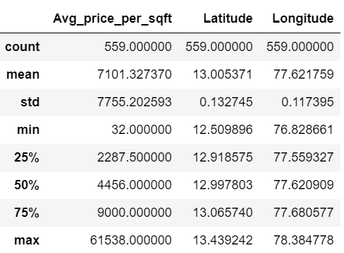
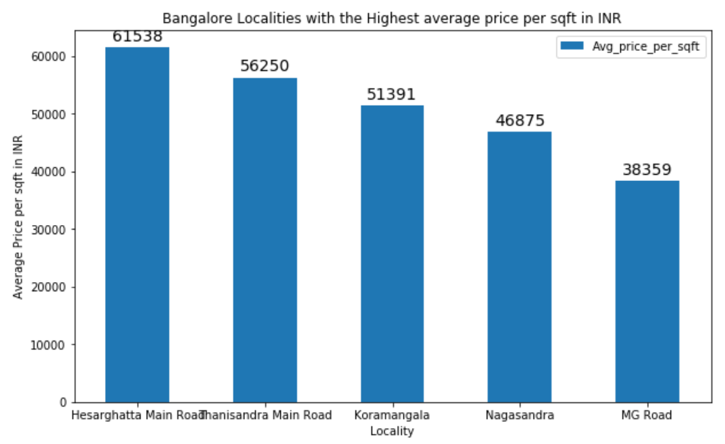
Data Exploration
Statistical Summary
Localities with the Highest Average Price per sqft

Slide 5
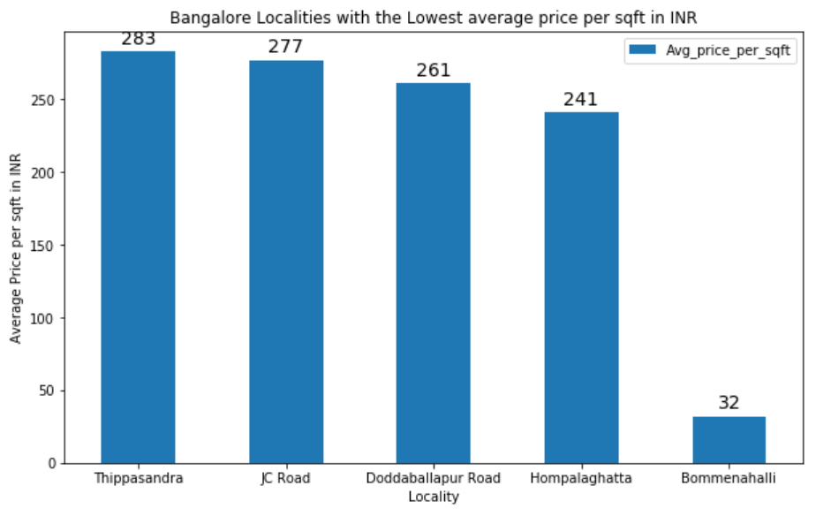
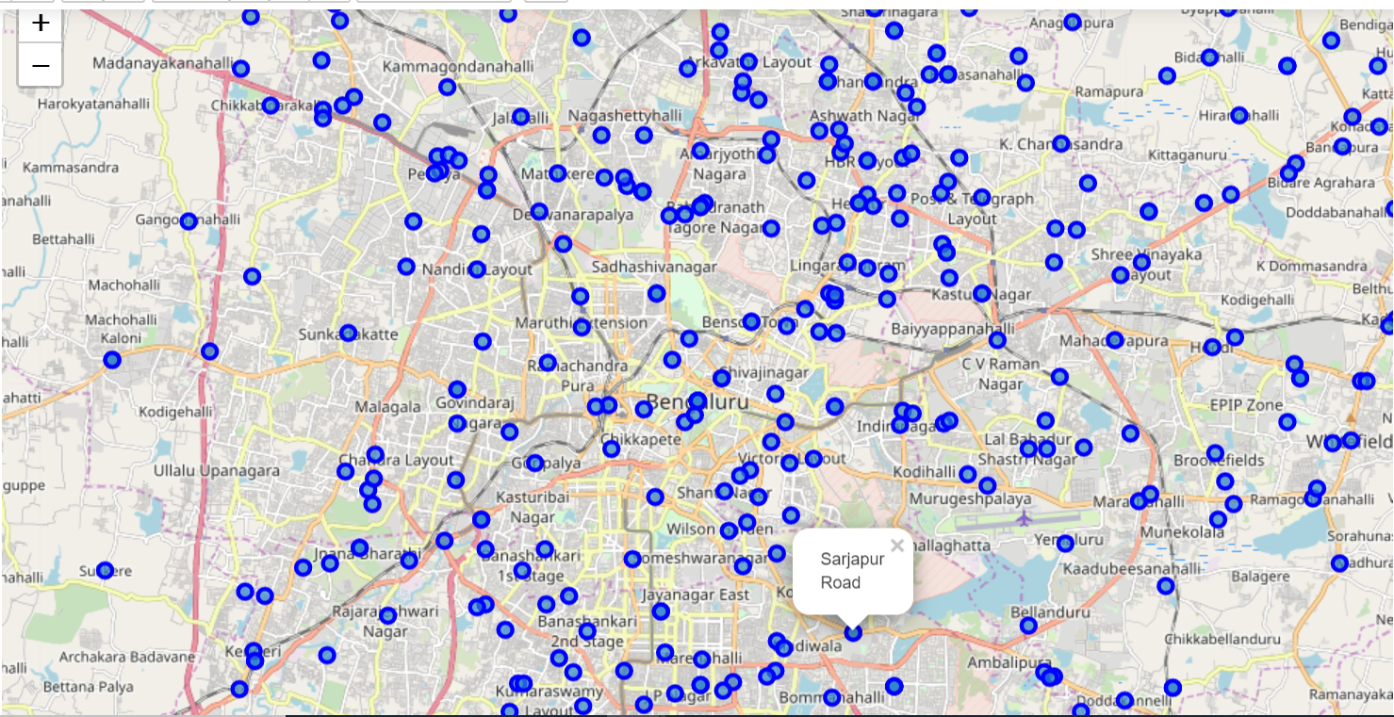
Data Exploration
Localities with the Lowest Average Price per sqft
Map of Bangalore with its Localities/Neighborhoods

Slide 6
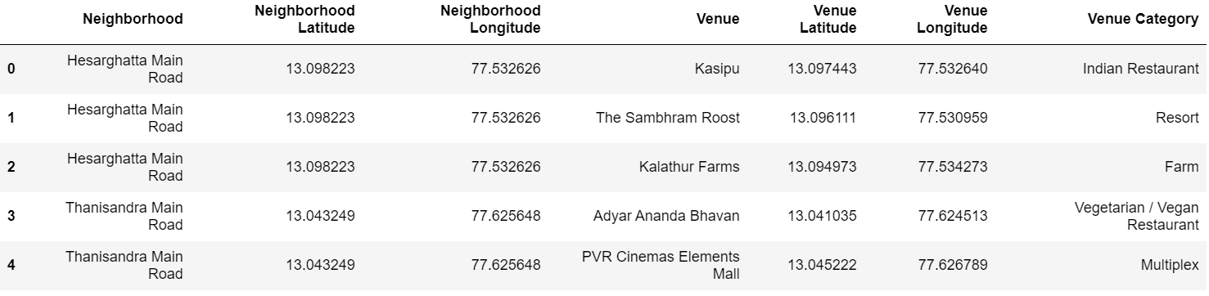
Data Exploration
Explore neighborhoods of Bangalore: - To explore the neighborhoods and segment them, used Foursquare API. Here, listed the list of venues, category, latitude and longitude which were returned from the Foursquare API when limit (no of venues return by Foursquare) as 100 and radius as 500 meters (distance for each neighborhood from their latitude & longitude).

Slide 7
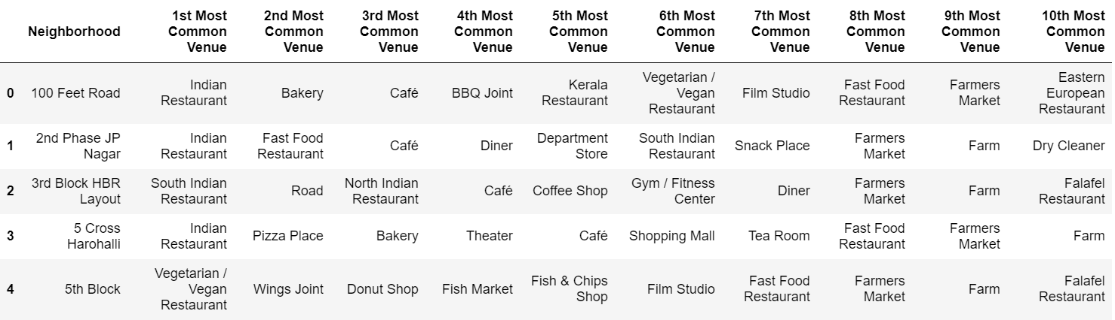
Data Exploration
Analyze each neighborhood: - Finally generated a new data set, which shows the top 10 most common visited venues for each neighborhood in Bangalore, with the help of Foursquare API.

Slide 8
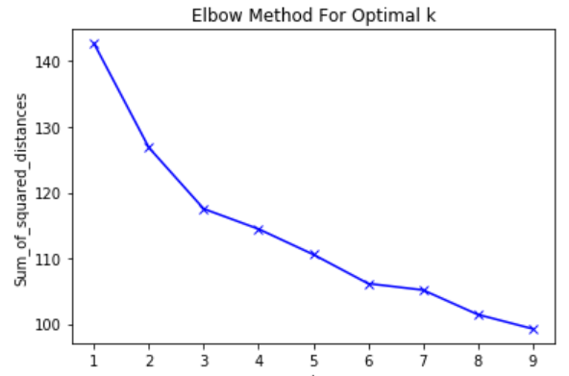
Machine Learning
Chosen, frequently used un-supervised machine learning, K-means algorithm to cluster neighborhoods since there are some common venue categories in the neighborhoods. K-means is used to cluster or segment similar objects/items.
Ran K-means to cluster the neighborhoods into 3 clusters as elbow method return the optimal number of clusters as 3 for this data. Elbow method is one of the mostly used techniques to find the best number of clusters in K-means.

Slide 9
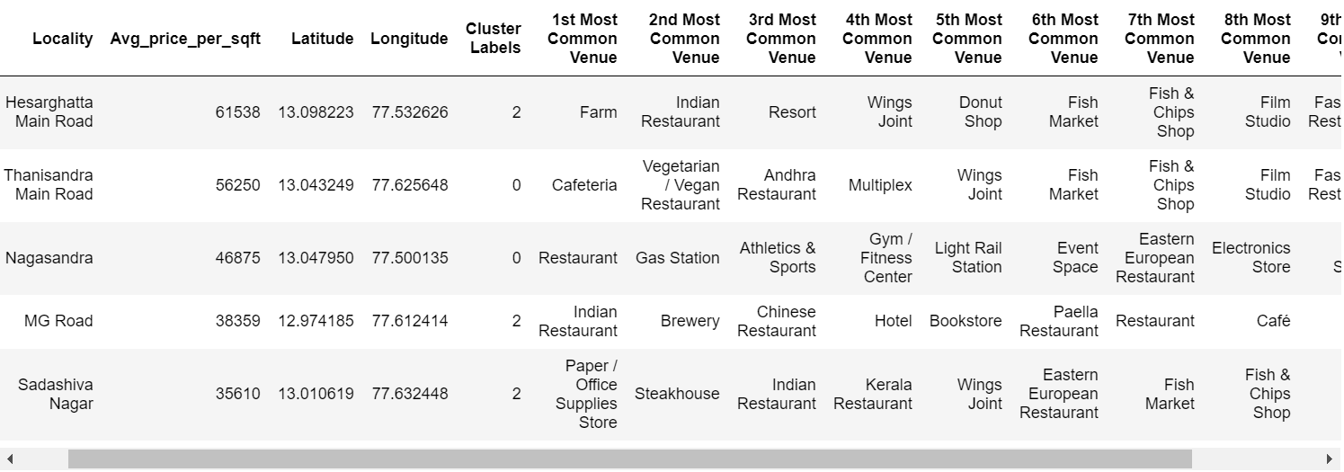
Result
Depicted resulted table that includes cluster and the top 10 venues for each neighborhood.

Slide 10
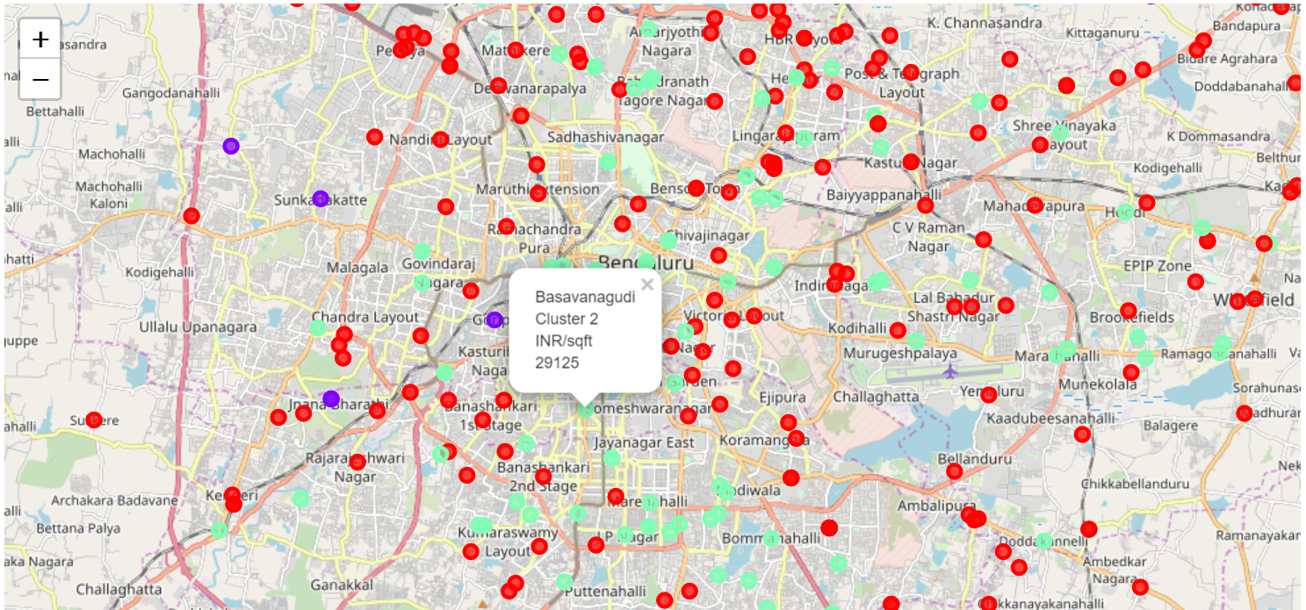
Result
Map of visualization of the resulted clusters.
Red - Cluster 0 Blue - Cluster 1 Green - Cluster 2

Slide 11
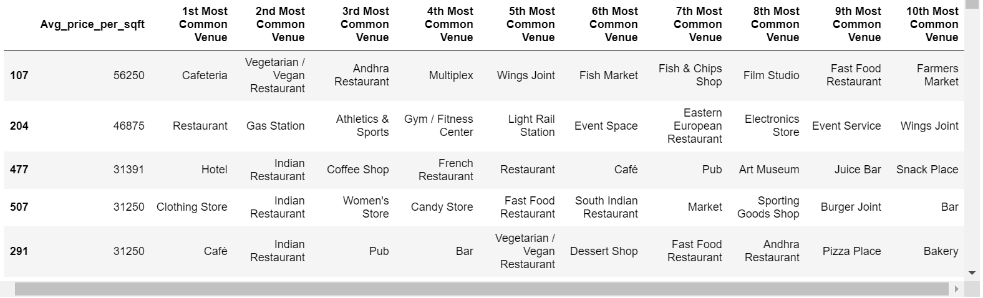
Result
Cluster 1

Slide 12
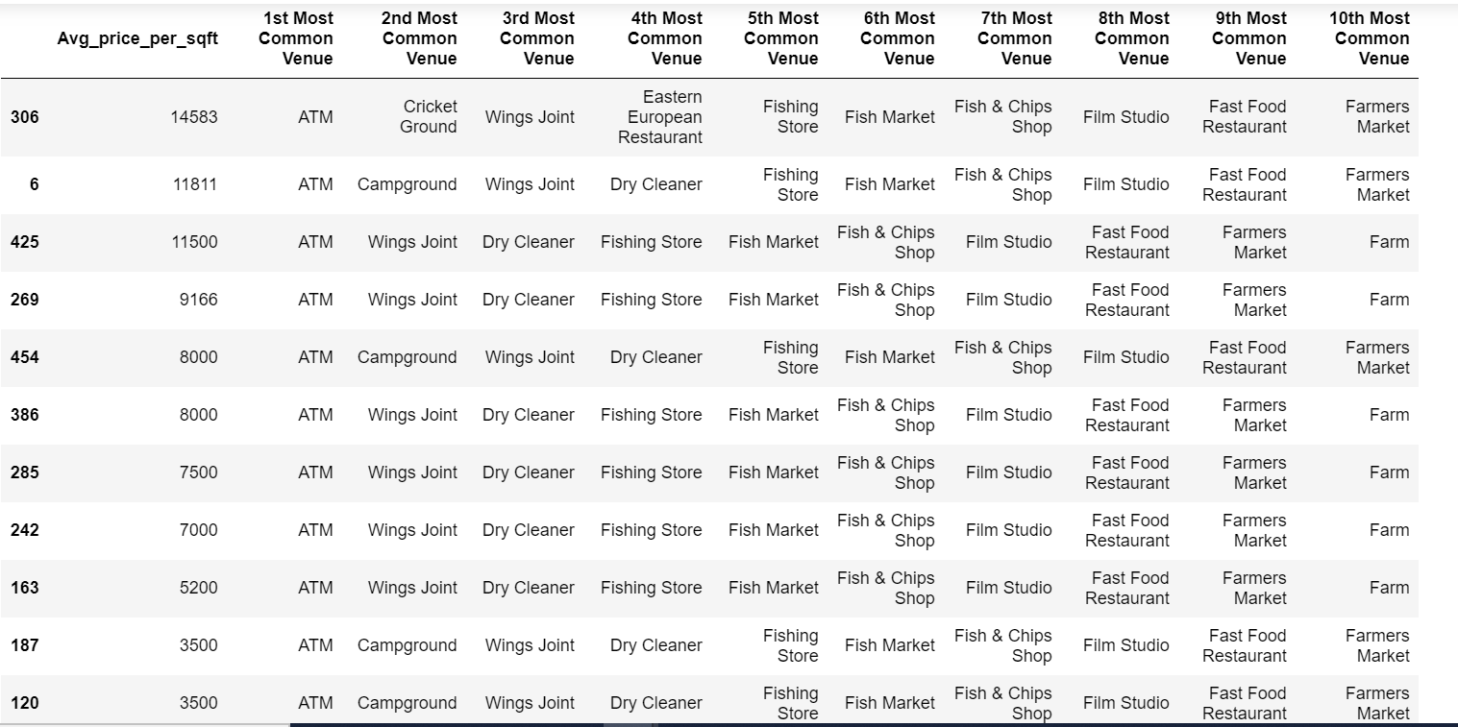
Result
Cluster 2

Slide 13
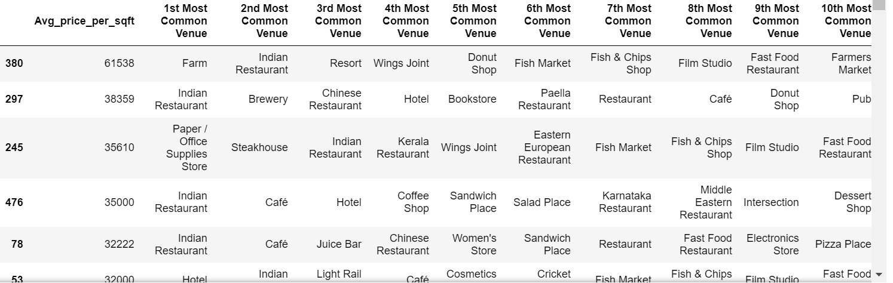
Result
Cluster 3

Slide 14
Conclusion and Future Directions
Conclude that this helps people to easily interpret where to live and invest with desirable amenities and affordable price in the neighborhoods of Bangalore.
Can get more accurate real estate price data.
Can improve the model performance by evaluating with different algorithms.

